Slide 1

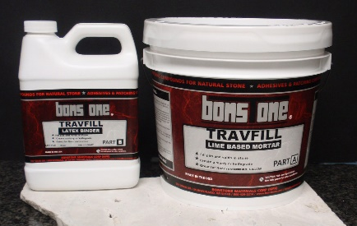

TECHNICAL DATA SHEET
FILE UNDER DIVISION 4
800-425-2214 I www.bonstone.com
1. PRODUCT NAME
BONSTONE ®
4. INSTALLATION
Surface Preparation & Use: Use gloves, wear eye protection, and avoid skin contact. When grinding cured materials, wear a dust mask. Mix only the amount of material which can be used in 15 minutes. Clean uncured TravFill from tools with hot, soapy water. Remove cured material mechanically.
Recommend testing an area of the floor before applying sections
Temperature dependency:
Temperature will affect the
working properties of the TravFill material. Minimum temperatures are above 5OF.
TravFill
2.MANUFACTURER Bonstone Materials Corporation
Coverage: The coverage of the TravFill depends on the size of holes and overfill on tile.
5.AVAILABILITY Packaging and storage:
BONSTONE® TravFill
Its packaged in 7 pound kits
( 5 lbs part A powder and 2
lbs latex binder part B)
Shelf life is approximately one year if kept in unopened cans in a dry area at 75°F.
WARRANTY
This warranty is limited to
Replacement of defective material and freight charges to destination only. Bonstone Materials Corp. is not responsible for consequential damages.
MAINTENANCE
Designed for application in areas inaccessible to maintenance procedures.
3. PRODUCT DESCRIPTION
A two-component, lime-based, latex modified filler material for travertine floors, smooth surface fills of natural stone, fabrication of stone slabs. Also for restoration of other porous stones like limestone, sandstone and marble. Interior and exterior use
.
Mixing instructions:
All materials should be at or above 55°F. Priming: For best adhesion, do not apply product to dry surfaces- light misting is appropriate. MIX PART B WELL BEFORE USING. Combine the two ingredients of powder and liquid until a slurry or knife grade desired consistency. Determine the powder to liquid propo1iion that works and handles the best for you particular application. Use iron oxide powdered tints for custom matching. Use a straight edge trowel to spread out the material while leaving a 1/32 to 1/64 inch over-fill on tile. Use floor machines to remove large floor sections. For honed surfaces mechanically re using sand paper.
Basic Uses:
Filling voids and pits in travertine and marble
Skim coating vertical stone
Designed for marble aesthetic repairs
Creates a travertine like honed finish
Easy to mix and apply to your surface
Designed as a slurry or knife grade application
Slight over fill technique for floor machining
8. TECHNICAL SERVICE
specifications for various applications
specification writing dept. for unique application
Limitations:
Use on oil, grease, and coating free substrates.

